Slide 1

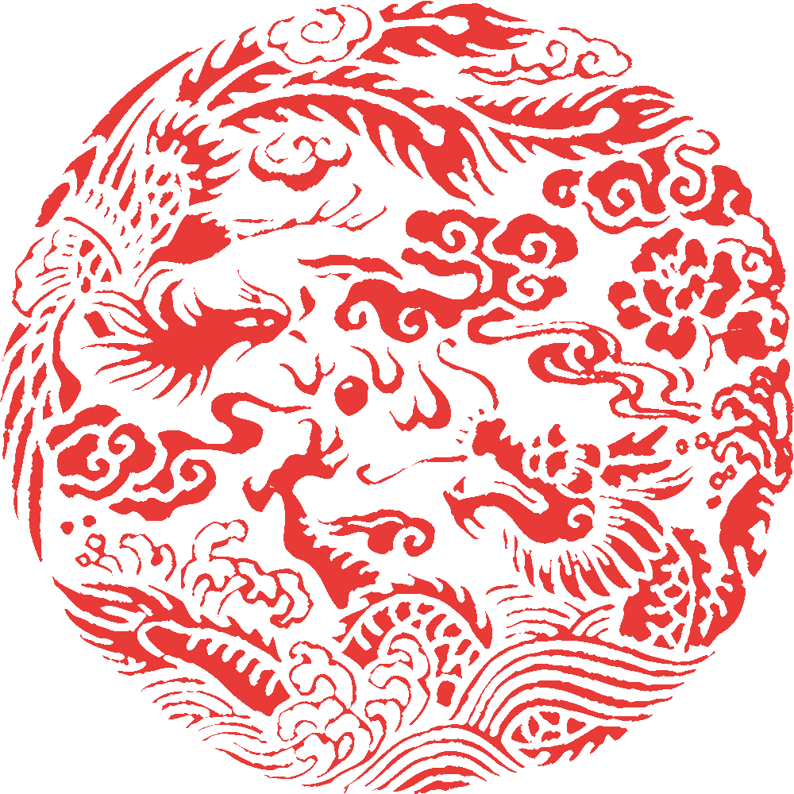
POLITE BEHAVIOUR AND WORK ETHIC IN CHINA
PRESENTED BY ANISH BASU & KAUSHIK KACHHAP

Slide 2

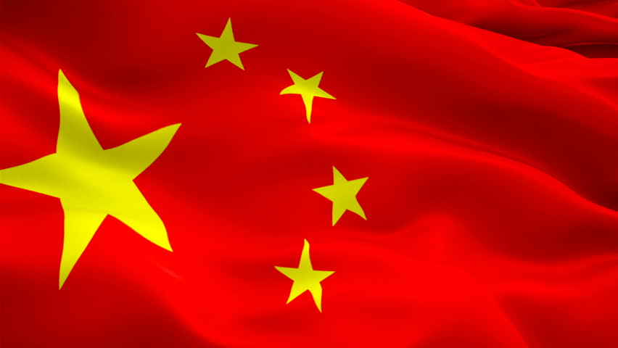

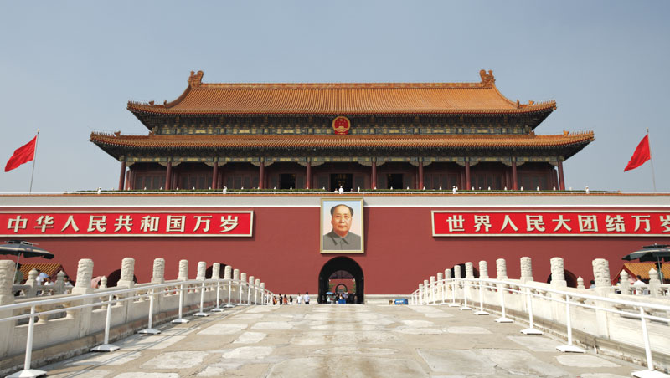
INTRODUCTION
China is one of the four great ancient civilizations of the world, together with ancient Egypt, Babylon and India.
The first light of Chinese civilization revealed itself 7,000 to 8,000 years ago.
A
It is the world's most populous country, with a population of around 1.404 billion in 2017. Represents 20% of world’s population. Every five people of planet is a resident of China.
China's economy has been one of the world's fastest-growing with annual growth rates consistently above 6 percent.
China is one of the most polluted country in the globe.
The government of the PRC officially espouses state atheism,but religions like Taoism (74%) , Buddhism (16%) and Christianity (3%) exist.

Slide 3

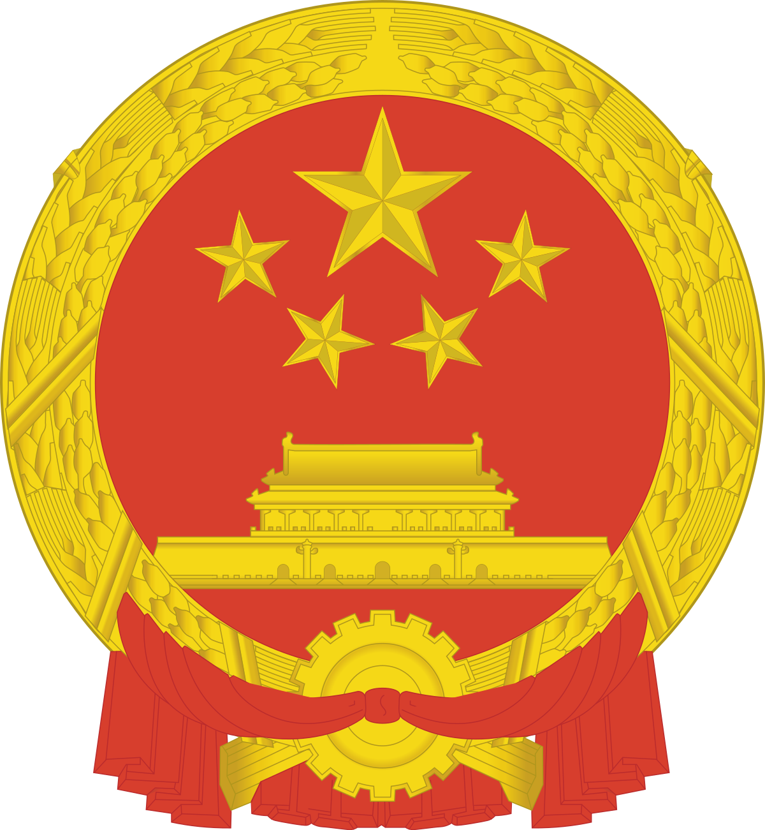


Historical Timeline of China
REPUBLIC
PERIOD
221-206 BC
QIN DYNASTY
618-907 AD
TANG DYNASTY
1912-
1949 AD
2200-
1600 BC
206 BC-
220 AD
618-907 AD
1949-
NOW
XIA DYNASTY
HAN DYNASTY
MING DYNASTY
PEOPLES’
REPUBLIC OF CHINA

Slide 4
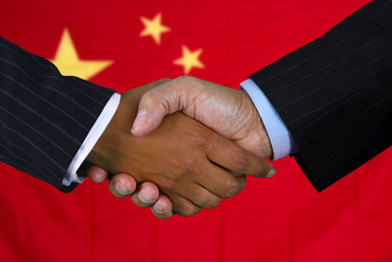
Greetings in China
Do’s
Do greet others by using a handshake or a nod
Do address the eldest or most senior person first.
Do address seniority by an honorory title (family relationship or e.g. 'teacher': laoshi) or by the family name plus Mr. (Xian sheng), Ms. (nvshi).​​
Don’ts
Don’t offer too firm of a handshake. A firm handshake could be construed as a sign of aggression.​
Don’t go straight for a hug.
Don’t address elders using ‘ni hao’ (/nee haow/). Instead, use ‘Nin hao’ (/neen-haow/ ‘you good’).

Slide 5
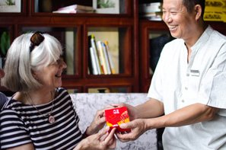
Giving and Receiving Gifts
Do’s
Do Present and receive things with both hands.
Do refuse a gift a number of times before accepting it. Politely refusing a gift before accepting it is the norm in Chinese culture.
Do gift small items like books, music CDs, perfumes, cigarettes and candies from your home country (or a well-known Chinese brand).​​
Don’ts
Don’t be too eager to unwrap your gift.
Don’t gift clocks or other symbolic items. Clocks and things related to the number four are associated with death in China, and sharp objects symbolize the severing of relationships.

Slide 6
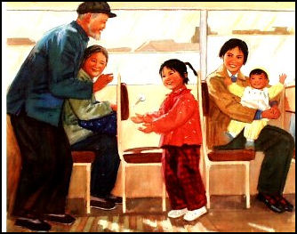
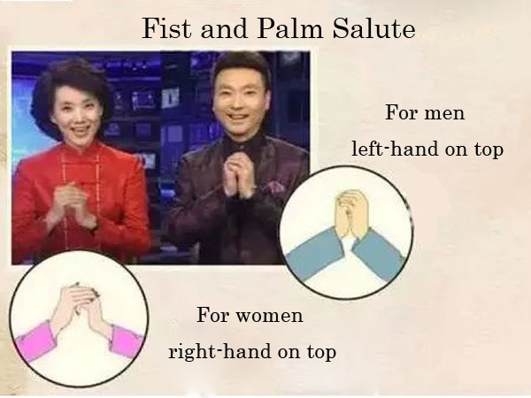
Respect For Older People in China
Customs
Younger people are expected to defer to older people, let them speak first, sit down after them and not contradict.
People are often introduced from oldest to youngest.
When offering a book or paper to someone older than you, you should show respect by using two hands to present the object.
Taboos in doing the Fist and Palm Salute
When you are attending funeral, you should do the fist palm salute on the opposite way. Right-hand on the top for men and left-hand on top for women.
The gesture is not suitable to use in big and official occasions such as the National People's Congress.

Slide 7
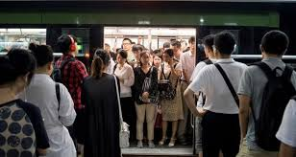
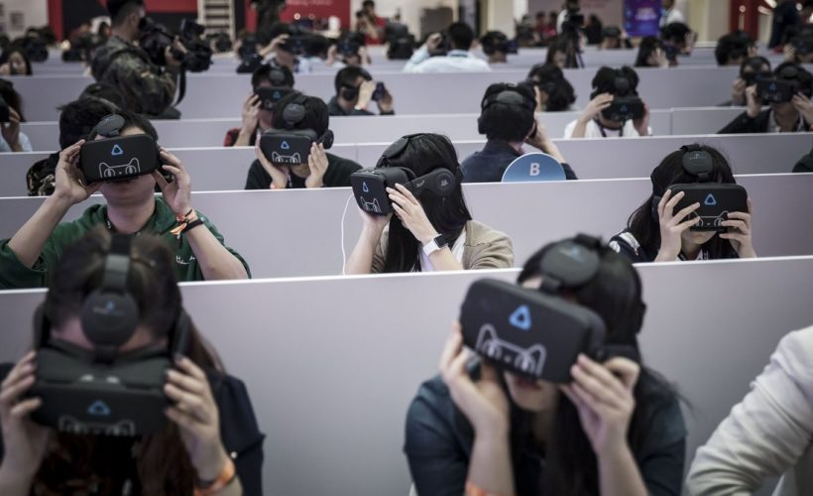
Work Ethic
1)Time Perception , punctuality is considered extremely important in China and is even considered a virtue.
2)Focus on results , The Chinese have several proverbs that demonstrate their attitude towards hard work
3) “Chi Ku” – the act of persisting through hardship. Chi Ku is a valued way to earn respect — and possibly a promotion.
4)Success isn’t left to chance , We’ve heard the saying “hard work
beats talent” Well, that’s something the Chinese attest to.

Slide 8
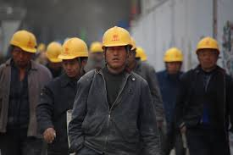
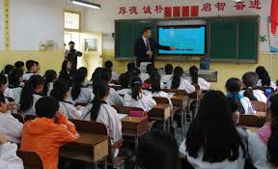
Work Ethic
5) Striving for Perfection , This isn’t to say that people from other parts of the world aren’t hardworking, but the Chinese are hard-wired to achieve success. Being competitive and having a goal-oriented spirit is inherent to every Chinese person and is further instilled at a very young age.
6) Laziness is a crime , American satirist Mark Twain once observed that “a lazy Chinaman does not exist,” and added, “He always manages to find something to do.”
7) Don’t just work hard, work smart , Everyone in China strives to do their best, especially when the going gets tough

Slide 9


